Slide 1
Hardening your Infrastructure with a Vault

Slide 2



whoami
Luís Duarte
Software Engineer - OSS contributor
BSc Degree @
driverpt @

Slide 3
What’s a secret?
“Something not known or not to be seen by others”

Slide 4
How to store secrets
Text Files
Password Managers (KeePass, LastPass, etc...)
Post-It Stickers
Notebook handwriting (Book of Secrets)
Git Repository

Slide 5
How do companies manage secrets ?

Slide 6
How do companies manage secrets ?
<blank>

Slide 8
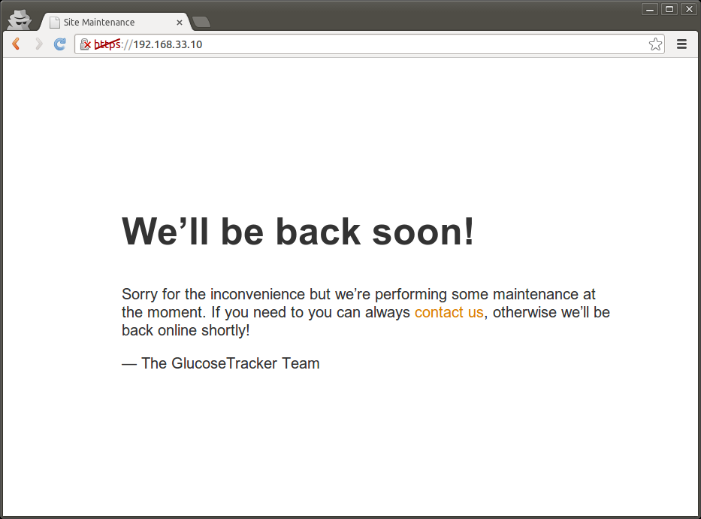

Slide 9


Slide 10
What to do in case of Data Breach?
Revoke all users and passwords
Change database hostnames
Create new users and passwords
Reconfigure all infrastructure with new data (restart)

Slide 11

Hashicorp Vault

Slide 12
Features
Dynamic Secrets (Created on demand)
Key Rolling
Data Encryption
ACL’s
Leasing, Renewing, Revocation
Audit Log
Multiple 3rd-party authentication plugins
REST API

Slide 13
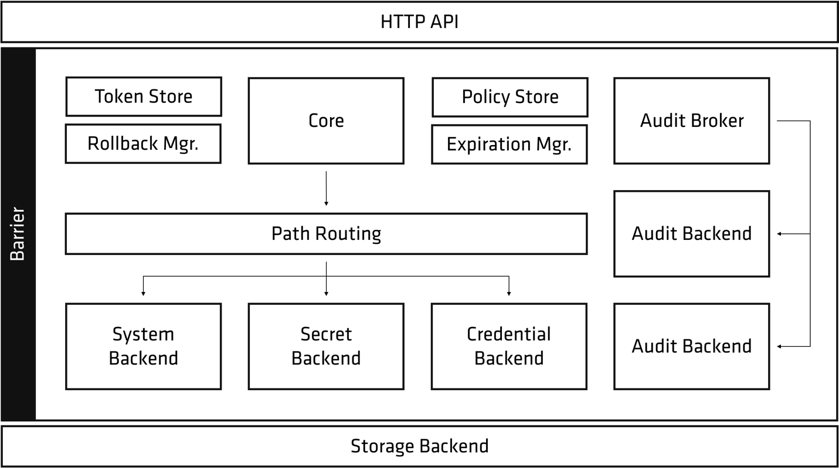
Architecture

Slide 14
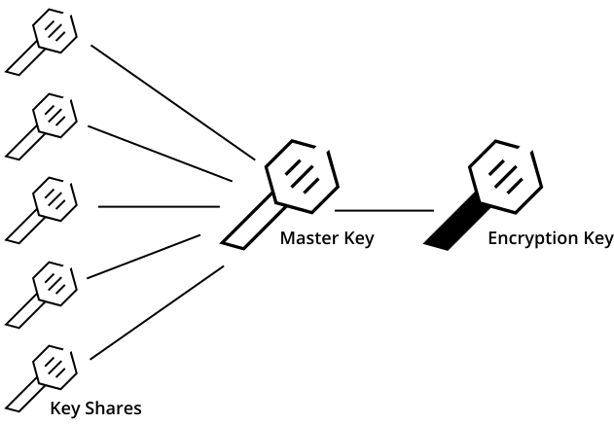

Slide 15
Supported Secret Backends
SSH
Databases (Postgres, Oracle, MySQL, etc…)
PKI
Key-Value Store
AWS
RabbitMQ

Slide 16
Example
Via CLI:
vault write secret/foo value=bar value2=baz
vault read secret/foo
Via REST API
curl --request POST https://vault.local:8200/v1/secret/foo --data “value=bar&value2=baz”
curl https://vault.local:8200/v1/secret/foo

Slide 17

How to spin this off?
Login
Credentials
Token
Start Doing Stuff

Slide 18
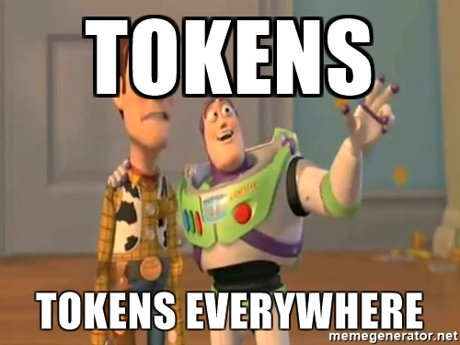
Everything is Token Based

Slide 19
Fundamental Theorem of Software Engineering
"We can solve any problem by introducing an extra level of indirection."

Slide 20
DEMO

Slide 21
How to control access to what and for how long?

Slide 22
Features
Dynamic Secrets (Created on demand)
Data Encryption
Key Rolling
ACL’s
Leasing, Renewing, Revocation
Audit Log
Multiple 3rd-party authentication plugins
REST API

Slide 23
Access Control Lists (ACL)
Written in JSON or HCL
Default Policy is ALWAYS Deny by default
All Token policies are atomic
Fine-grained Control

Slide 24
Policy Example (HCL)
path "secret/foo" { capabilities = ["create", “update”, “read”, “delete”] denied_parameters = { "bar" = [] } allowed_parameters = { "*" = ["foo-*"] }
}

Slide 25
DEMO 2

Slide 26
What to do in case of Data Breach?
DO NOT PANIC!
Seal Vault (If you suspect if hackers are deep inside)
Revoke all Tokens
Generate new Tokens (Re-Login into Vault)

Slide 27
Best-Practices
Keep ACL’s Small
Use token-create to test out new policies
Restart App Containers on Policy Changes (New Tokens)
Destroy Root Token in Production
Make sure default policy has minimal access

Slide 28
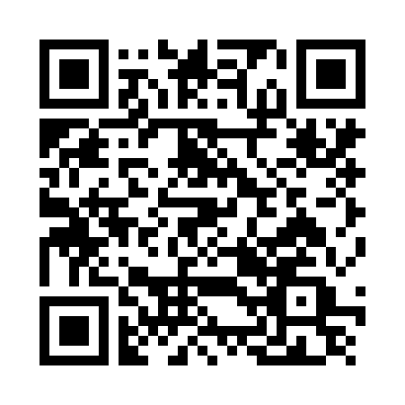
Source Code for this Presentation
https://github.com/driverpt/pixelscamp-hardening-infrastructure-with-vault

Slide 30


